Slide 1
OAUTH 2.0 & OIDC
Presented By: Jeffery Afutu

Slide 2
Agenda
01
Introduction to Authentication & Authorization
02
OAuth 2.0
03
OpenID Connect (OIDC)
04
Differences Between OAuth 2.0 & OIDC
05
Labs

Slide 3
Introduction to Authentication & Authorization
01

Slide 4
Authentication and Authorization
Overview
Key Features
Authentication (Who are you?)
Purpose: Verifies the identity of a user/system.
Methods:
Passwords (e.g., username + password)
Multi-Factor Authentication (MFA) (e.g., SMS code + password)
Biometrics (e.g., fingerprint, face recognition)
OAuth 2.0 / OpenID Connect (e.g., "Sign in with Google")
Example:
Logging into your email with a password.
Scanning your face to unlock your phone.
Authorization (What are you allowed to do?)
Purpose: Determines permissions (what resources a user can access).
Methods:
Role-Based Access Control (RBAC) (e.g., admin vs. user roles)
Permissions (Scopes) (e.g., read:data, write:data)
OAuth 2.0 Tokens (e.g., an access_token with scope=read)
Example:
An admin can delete users, but a regular user cannot.
A weather app requests read-only access to your location.

Slide 5
What is OAuth 2.0?
02

Slide 6
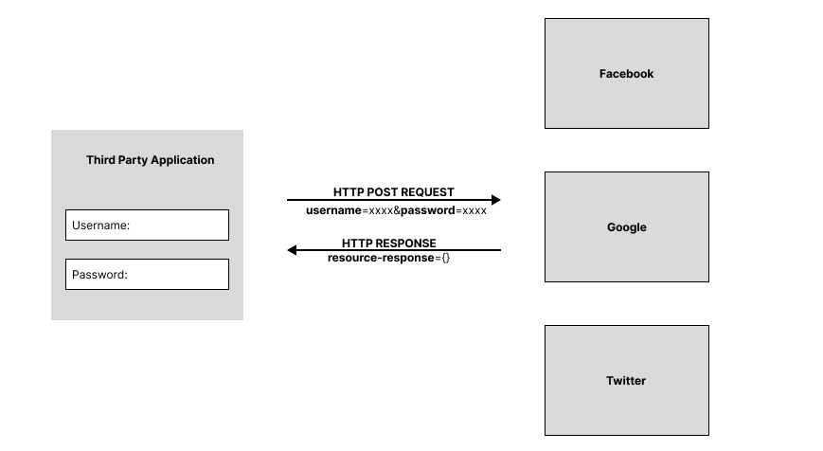
Traditional Approach
In the traditional client-server model, users (resource owners) must share their passwords with third-party apps to let them access protected resources. This approach has several problems:
Third-party apps have to store the user’s password, often in plain text.
Servers must allow password-based logins, which are insecure.
Third-party apps get full access to user data, with no way to limit what they can do or how long they can access it.
Users can't revoke access from just one app — they must change their password, which affects all apps.
Compromise in third party application results in compromise in end user's password.

Slide 7
OAUTH 2.0
What is Oauth 2.0?
Definition: An authorization framework for delegated access.
Purpose: Allows apps to access user data without exposing credentials.
Example:
A weather app accessing your location from Google.
OAuth 2.0 Roles
Resource Owner (User)
Client (Application requesting access)
Authorization Server (Issues tokens, e.g., Google Auth)
Resource Server (Holds protected data, e.g., Google APIs)
OAuth 2.0 Flow (High-Level)
User requests access via Client.
Client redirects to Authorization Server.
User authenticates & grants permission.
Authorization Server issues an Access Token.
Client uses token to access Resource Server.
OAuth 2.0 Grant Types
Authorization Code (with PKCE) - Secure for public clients.
Client Credentials - Machine-to-machine communication.
Implicit (deprecated) - For browser apps.
Resource Owner Password (deprecated) - Uses user credentials directly.

Slide 8
OpenID Connect (OIDC)
03

Slide 9
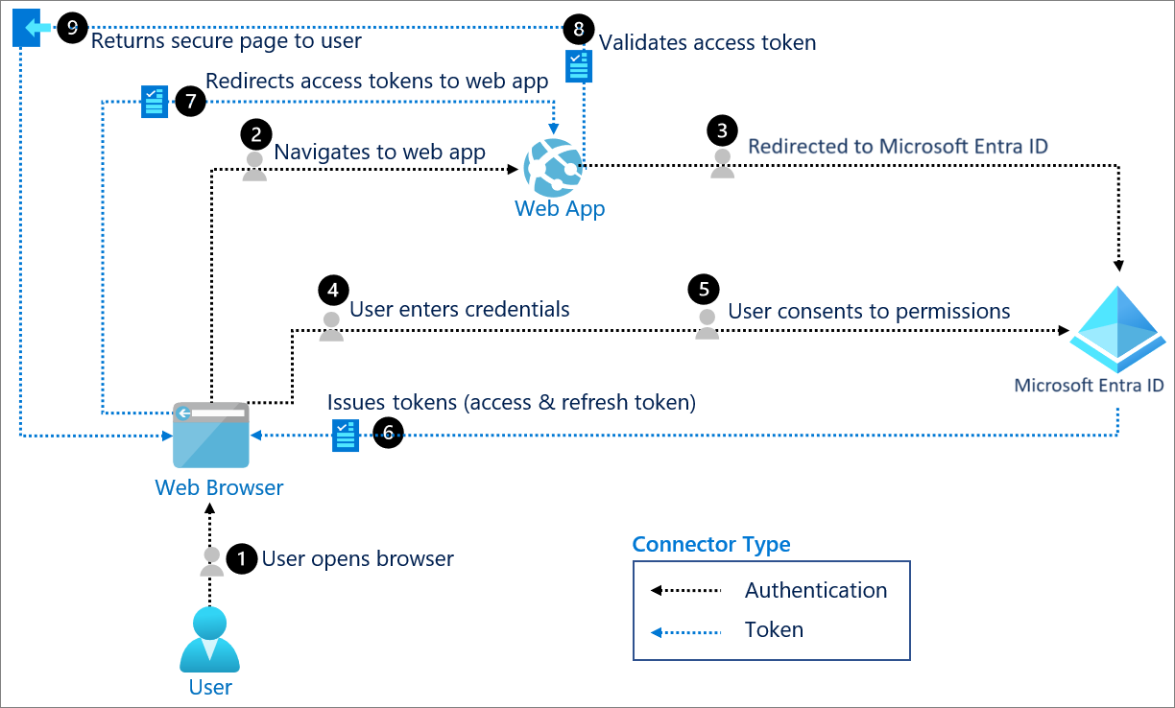
OpenID Connect (OIDC)
Definition: An authentication layer on top of OAuth 2.0.
Purpose: Verifies user identity and provides profile info (ID Token).
Example: "Login with Google" on a website.

Slide 10
Differences Between OAuth 2.0 & OIDC
04

Slide 11
OAuth 2.0 vs OIDC
Feature | OAuth 2.0 | OpenID Connect (OIDC)
Purpose | Authorization | Authentication + Profile Data
Token | Access Token only | Access Token + ID Token
User Info | No standard user claims | Standardized user claims (name, email, etc.)
Discovery | No standard discovery | .well-know configuration endpoint
Use Case | API Access | Single Sign-On (SSO)

Slide 12
Labs
05

